Slide 1

Introduction to Artificial Intelligence
Prepared by
Lec Shekh. Md. Saifur Rahman
PREPARED BY
SWAPNIL BISWAS

Slide 2
Reference Book
Artificial Intelligence: A Modern Approach
- Stuart Russell and Peter Norving

Slide 3
Goals of this Course
This class is a broad introduction to Artificial Intelligence (AI)
AI is a very broad field with many subareas
We will cover many of the primary concepts/ideas

Slide 4
Why AI can change our life…
As we begin the new millennium
- Science and technology are changing rapidly
- “Old” sciences such as physics are relatively well–understood
- Computers are ubiquitous
Grand challenges in science and technology
- Understanding the brain
Reasoning, cognition, creativity
- Creating intelligent machines
Is this possible?
What are the technical and philosophical challenges?
- Arguably, AI poses the most interesting challenges and questions in computer science today

Slide 5
This Lecture
What is intelligence? What is artificial intelligence?
A very brief history of AI
Modern successes: Stanley, the driving robot
An AI scorecard
How much progress has been made in different aspects of AI
AI in practice
Successful applications
The rational agent view of AI

Slide 6
What is Intelligence?
Intelligence:
“The capacity to learn and solve problems” (Webster’s dictionary)
In particular,
The ability to solve novel problems
The ability to act rationally
The ability to act like humans

Slide 7
What’s involved in Intelligence?
Ability to interact with the real world
To perceive, understand, and act
E.g., speech recognition, understanding, and synthesis
E.g., image understanding
E.g., the ability to take actions, have an effect
Reasoning and Planning
Modeling the external world, given input
Solving new problems, planning, and making decisions
Ability to deal with unexpected problems, uncertainties
Learning and Adaptation
We are continuously learning and adapting
Our internal models are always being “updated”
E.g, a baby learning to categorize and recognize animals

Slide 8
What is Artificial Intelligence?
AI is a branch of computer science that focuses on creating systems or machines that can perform tasks typically requiring human intelligence. These tasks include:
Understanding language (Natural Language Processing)
Learning from experience (Machine Learning)
Solving problems and making decisions (Reasoning)
Recognizing patterns and objects (Computer Vision)
Understanding and generating speech (Speech Recognition and Synthesis)
Interacting with the environment (Robotics)

Slide 9
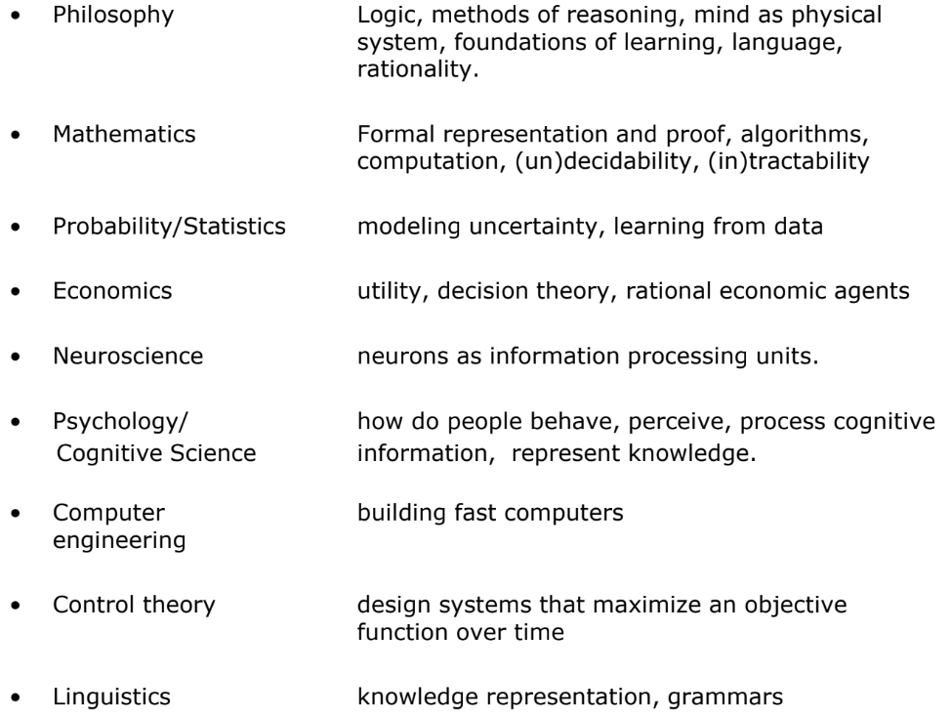
Academic Disciplines Relevant to AI

Slide 10
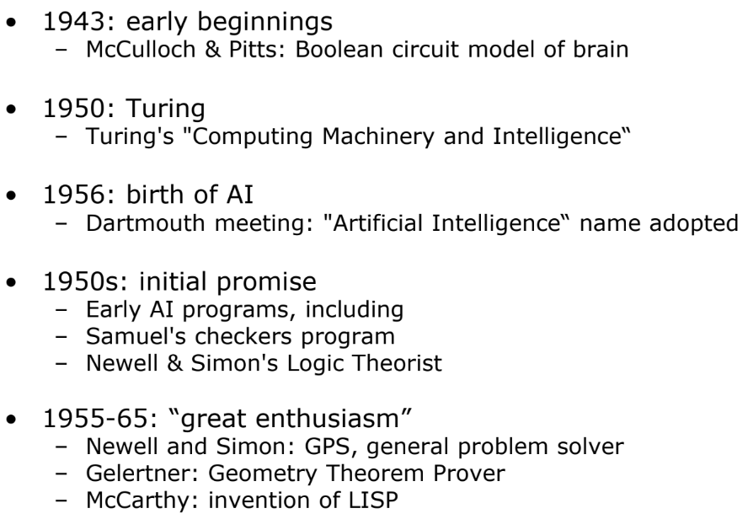
History of AI
→ Can machines think??

Slide 11
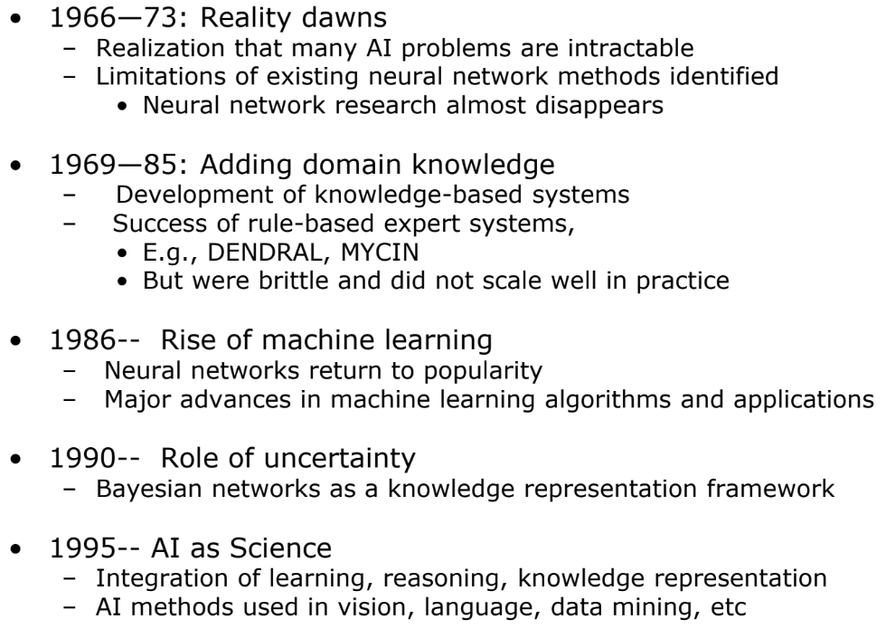
History of AI

Slide 12
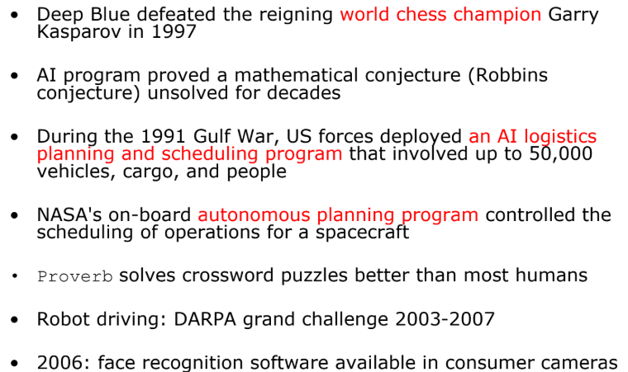
Success Stories

Slide 13
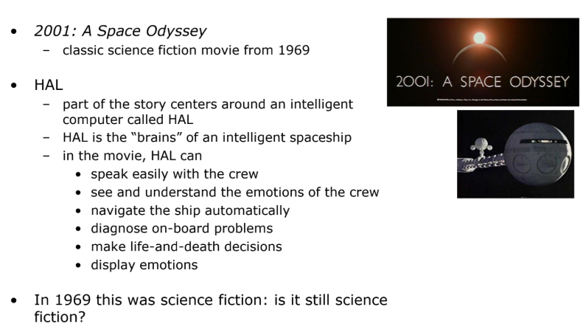
HAL: from the movie 2001

Slide 14
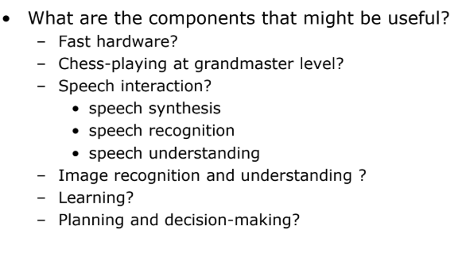
What might be involved in building a computer like HAL?

Slide 15
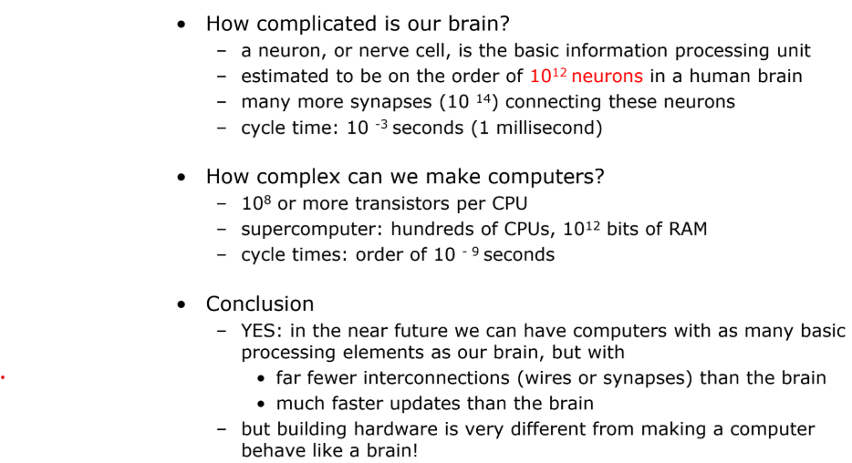
Can we build hardware as complex as the brain?

Slide 16
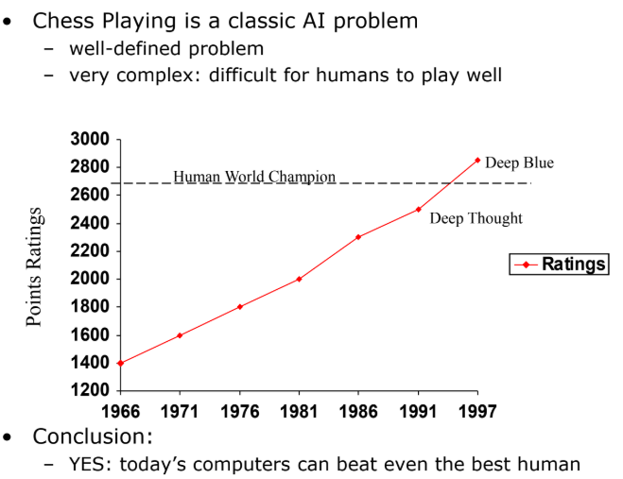
Can computers beat humans at chess?

Slide 17
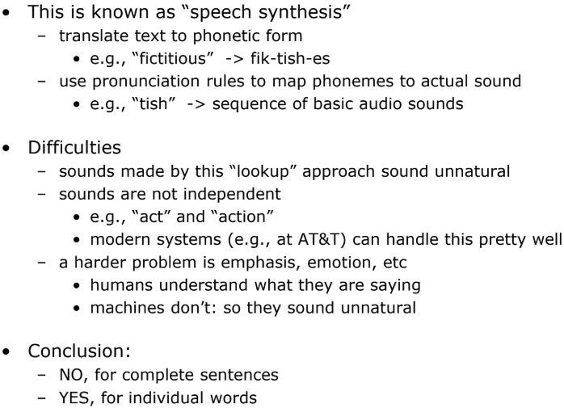
Can Computers Talk?

Slide 18
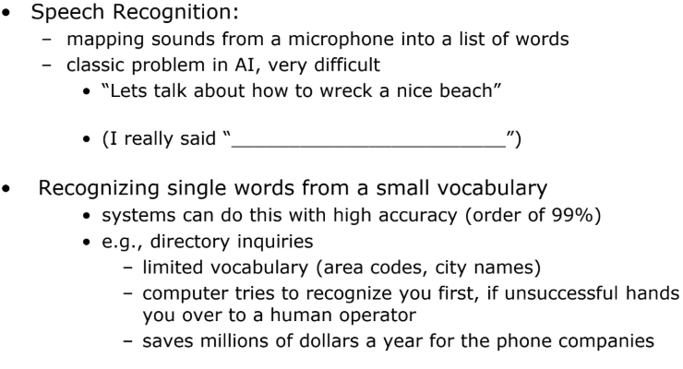
Can Computers Recognize Speech?

Slide 19
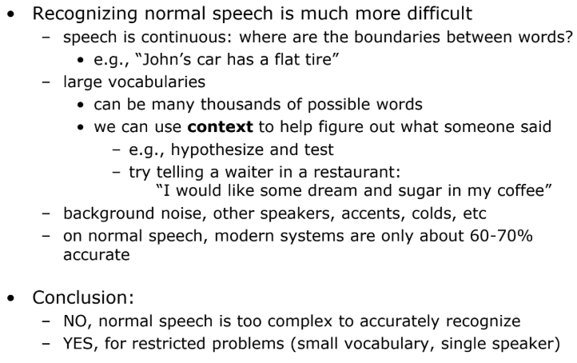
Recognizing Human Speech (ctd.)

Slide 20
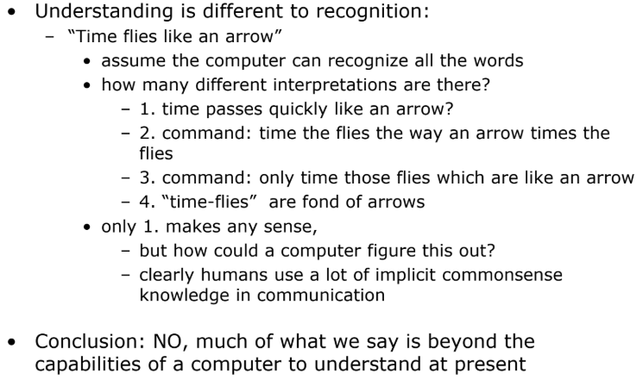
Can Computers Understand Speech?

Slide 21
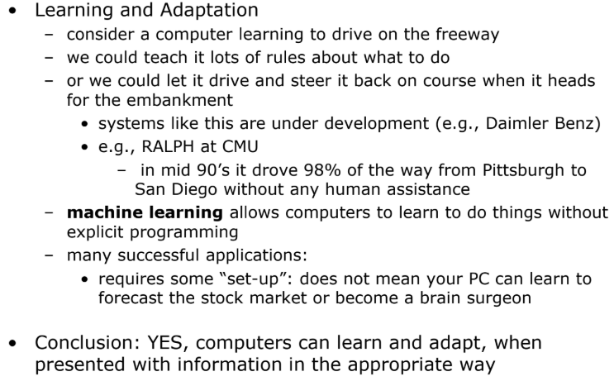
Can Computers Learn and Adapt?

Slide 22
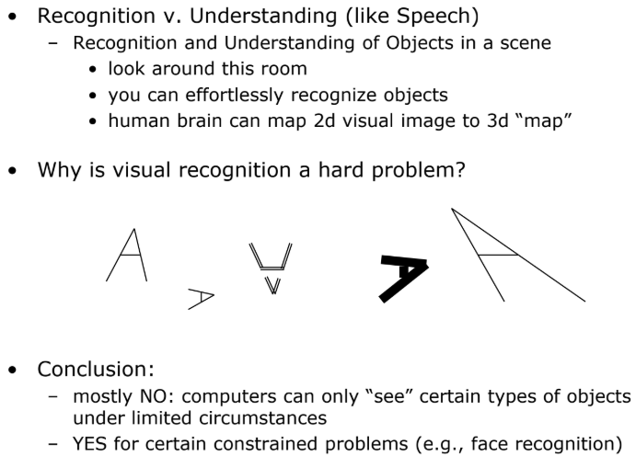
Can Computers “see”?

Slide 23
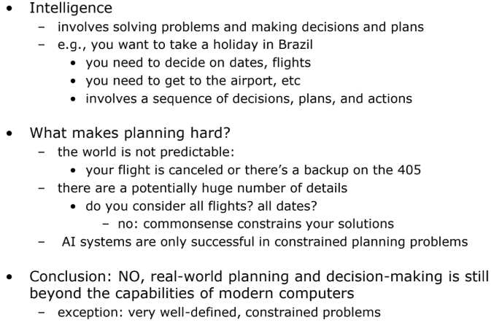
Can Computers Plan and Make Optimal Decisions?

Slide 24
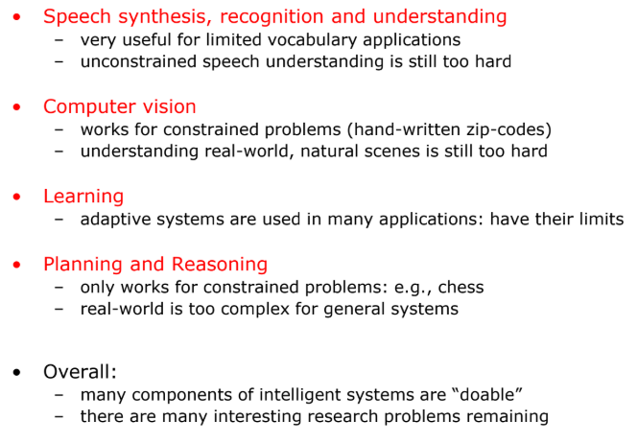
Summary of State of AI Systems in Practice

Slide 25
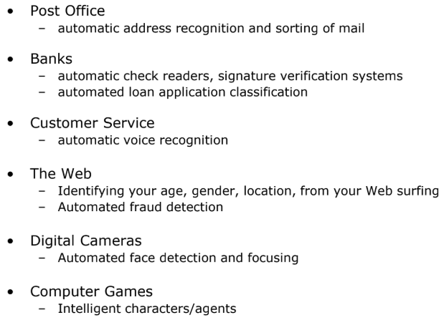
Intelligent Systems in Your Everyday Life

Slide 26
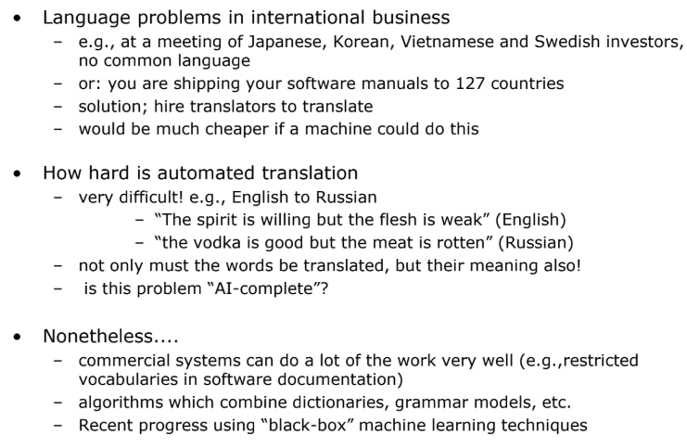
AI Applications: Machine Translation

Slide 27
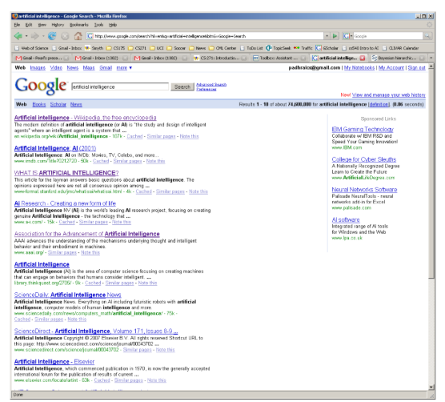
AI and Web Search

Slide 28
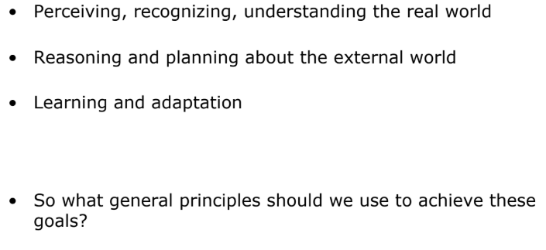
What’s involved in Intelligence? (again)

Slide 29
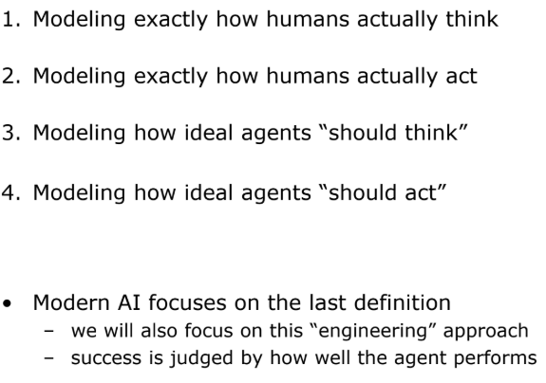
Different Types of Artificial Intelligence

Slide 30
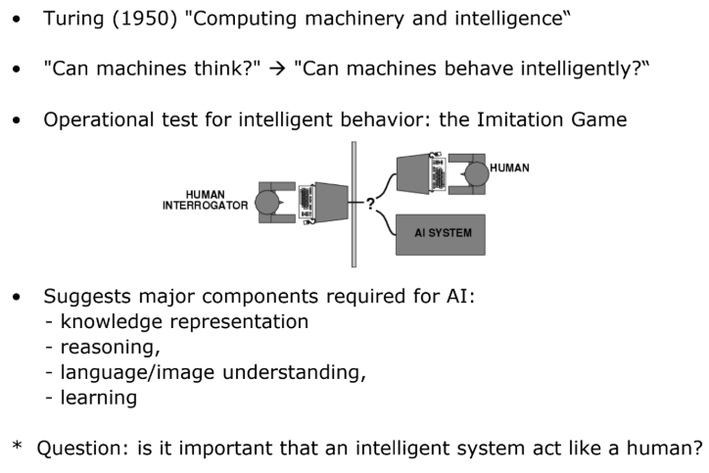
Acting Humanly: Turing Test

Slide 31
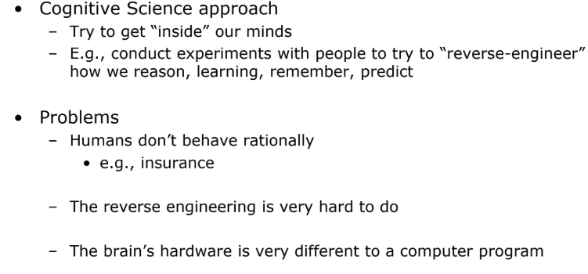
Thinking Humanly

Slide 32
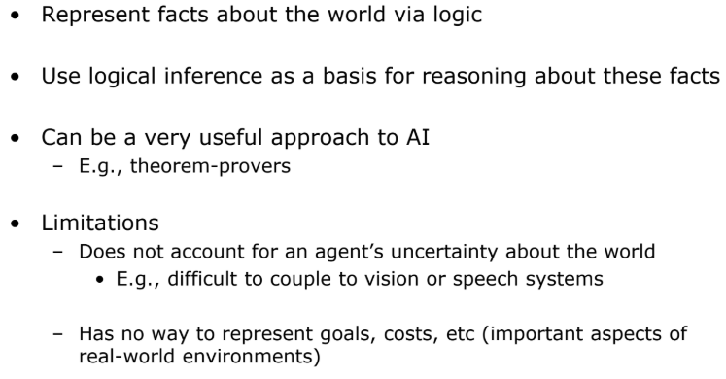
Thinking Rationally

Slide 33
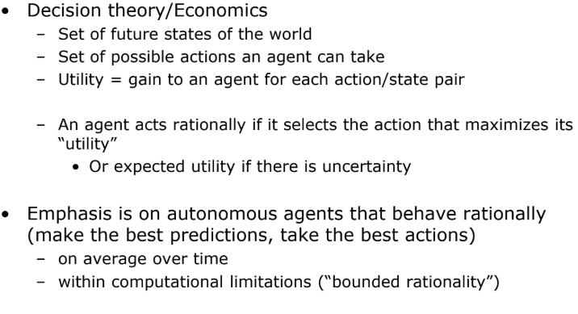
Acting Rationally

Slide 34
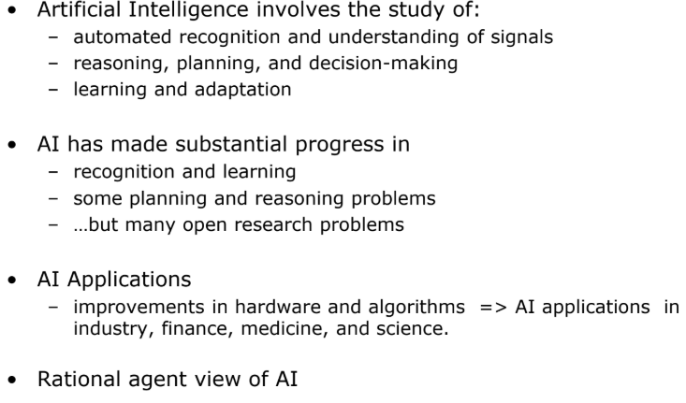
Summary

